Slide 1


Foundations of Entrepreneurship
Topic: Three Inspiring Stories
Manoj Kumar Mondal
RMSoEE
IIT Kharagpur
Lecture #: 02 (07.01.2021)
This Photo by Unknown author is licensed under CC BY.

Slide 2
Concepts Covered:
Entrepreneurship can be learnt from successful and failed stories.
Stories of Dhirajlal "Dhirubhai" Hirachand Ambani, Karshanbhai Patel, and Sophia Amoruso.
Successful entrepreneurs who started from humble background.
Their stories bust all myths of entrepreneurship.
Highly inspiring for any aspiring entrepreneur.

Slide 3
Our Primary Objectives from Today’s Session
What are the takeaways from these stories?

Slide 4
The story of a first generation entrepreneur per excellence – a rise from abject poverty to a great entrepreneur - Dhirubhai Ambani.
Know what it takes to succeed in entrepreneurship.
A real demonstration of a compelling vision and a well-crafted step-by-step strategies to achieve it.
Karsanbhai Khodidas Patel is a perfect model of entrepreneurship to be emulated.
Kalpana Saroj – the real “Slumdog Millionaire”.
Sophia Amoruso - a story of rags to riches and back and fightback? The rollercoaster rise, fall and rise.
Example of an accidental ‘push-type’ entrepreneur.

Slide 5
Dhirajlal (Dhirubhai) Hirachand Ambani (28 December 1932 – 06 July 2002)

Slide 6
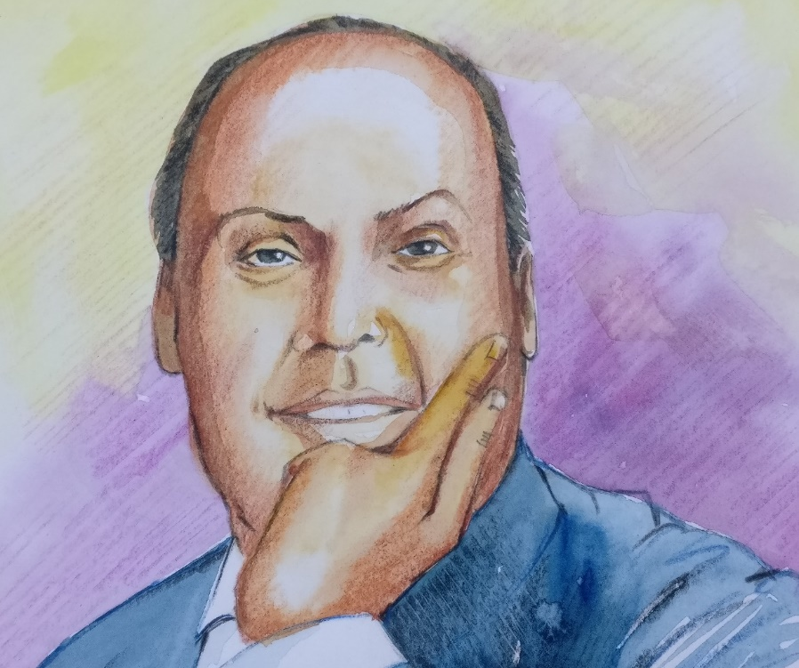
Dhirajlal (Dhirubhai) Hirachand Ambani (28 December 1932 – 06 July 2002)
An entrepreneur par excellence

Slide 7
Dhirajlal (Dhirubhai) Hirachand Ambani
He built Reliance Industries Ltd., India’s only private sector Fortune Global 500 company with market capitalization of ₹ 10 lakh crore#.
Set up world class refinery.
Best in class petrochemical plant using the best technology in the world.
That now contributes
3% of India’s GDP.
and 5% of export.
nearly 10% of India’s indirect tax collection.
Reliance Jio’s disruptive entry will expand India’s per capita GDP by about 5.65%, says a report by Harvard Business School.
# As on 28.11.2019

Slide 8
Dhirajlal (Dhirubhai) Hirachand Ambani (28 December 1932 – 06 July 2002)
Born in a poor family in a remote village in Gujarat.
Son of a village school teacher. But the family was in financial difficulty.
He used to retail cooking oil, onion / potato fry at the village market during weekends.
He was highly intelligent. Had high levels of physical and mental energy, strong will-power, zest for life, could undertake difficult activities and could complete them without looking back.

Slide 9
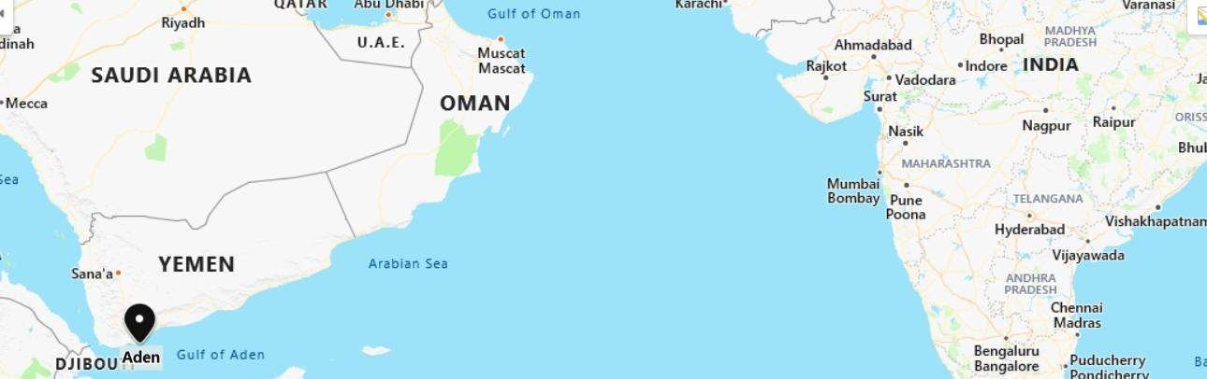
The Entrepreneurial Story of Dhirubhai Ambani
He had ambition to graduate and become successful businessman.
But the financial condition of his family was deteriorating.
On the advice of his ailing father, he dropped out of school and moved to Aden working as a petrol pump attendant.
He soon joined A. Besse & Co., a French Company at Aden.

Slide 10
The Entrepreneurial Story of Dhirubhai Ambani
He had always been a knowledge seeker.
He self-learnt export-import, commodity trading, marketing, distribution, currency trading, and money management.
He learnt trading skill and made exclusive contacts in trading and export business.
He extended free service to the Gujarati community at Aden to learn accountancy, banking, insurance, shipping documentation.

Slide 11
The Entrepreneurial Story of Dhirubhai Ambani
During lunch hour he used to engage in commodity trading and during weekends used to learn English.
When Shell Oil Refinery was set up in Aden, Dhirubhai was promoted to Manager of the new filling station of A. Besse & Co.

Slide 12
Dhirajlal (Dhirubhai) Hirachand Ambani
His ambition was to find petrol in India and set up refinery.
Returned to Bombay in 1958 with that vision.
But he did not have the money to start.
He looked for start-up opportunity.
Started ‘Reliance Commercial’ as a spice trader in early 60s.
His office comprised of a table and two chairs and he used to share a telephone with a neighbouring shop.

Slide 13
While doing a market research he realized Indian exporters were mostly focused on high margin and not on quality or delivery schedule. (they were focused on short term gain)
He identified THAT as an opportunity and started offering quality goods and delivered even before schedule.
He chose customers who valued quality.
Realizing that spice has limited volume he diversified into yarn-trading, dominated by multinationals such as Forbes, by pooling resources from friends and associates.
Notes:
He was circumspetive.

Slide 14
The Entrepreneurial Story of Dhirubhai Ambani
He made good money but distributed major part to the investors and gained their confidence and faith. His slogan was “Loss is mine, profit I share”. Thereafter, he could mobilize huge capital.
He introduced a shiny variety of yarn known as ‘Bamber’ in Indian market for ceremonial dress and was an immediate success giving him substantial capital.

Slide 15
The Entrepreneurial Story of Dhirubhai Ambani
In the 60s, India’s foreign exchange reserves was very low.
Import was allowed only for absolutely essential items.
Otherwise, import was allowed with the currency gained from export.
Many businessmen who were dependent on imported goods, went out of business.
The import-dependent businesses were in real adversity.

Slide 16
The Entrepreneurial Story of Dhirubhai Ambani
Dhirubhai could identify opportunity under such adverse situation.
Dhirubhai exported rayon to contacts in Aden at a loss to earn foreign exchange and imported synthetic fiber to sell in India almost like a monopolist.
He realised that converting nylon yarn into fabric adds more value than selling the yarn. So he put up a textile mill in Ahmedabad on a plot of 5000 sq yards that later was spread over 125 acres. He imported modern plant from Europe rather than buying second hand machine, the then tradition.

Slide 17
Dhirubhai Ambani
Maintaining best quality had always been his priority. The World Bank certified the textile mill as excellent even by developed country standard.
He always maintained network with people he were familiar with. Most of his top employees were his associates during his Aden days.
He bypassed the resistance by established mills by directly selling to retailers showing strong grit and determination.
He introduced his own brand as Vimal (pure).
Set up refineries that was regarded as the best in the world by a study by the World Bank.

Slide 18
Reliance Industries
contributes to about 3% of India’s GDP,
5% of export,
and nearly 10% of the country’s indirect tax revenues.

Slide 19
Dhirubhai Ambani
A poll conducted by The Times of India in 2000 voted him “The Greatest Creator of Wealth in the Century".
Reliance Jio Infocomm’s entry in September 2016 led to $10 billion in annual savings for India and an unprecedented surge in data consumption.
A 10% increase in internet penetration lead to 3.9% increase in per capita GDP, if all else remains constant.
'Reliance Jio's entry would boost India GDP by 5.65%’ [study by IFC]
Source: https://en.wikipedia.org/wiki/Dhirubhai_Ambani

Slide 20
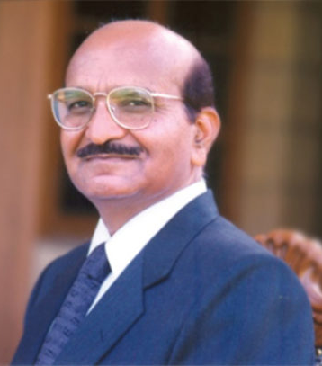
Karsanbhai Khodidas Patel
Karsanbhai Khodidas Patel is an Indian industrialist, founder of the Rs. 42500 crore Nirma group with major interests in cements, detergents, soaps and cosmetics.
Born in a family of farmer.
Graduated in Chemistry at the age of 21.
Worked as a lab technician.
In 1969 at the age of 24, Karsanbhai started manufacturing phosphate-free detergent powder, Nirma in his backyard.
He sold on his bicycle while going to his work place, which was 17km from his home.
The handmade detergent packets were sold at Rs. 3 per kg, one-fourth of cheapest popular detergents in the market.

Slide 21
Nirma, is now being recognized as
Selected as the super brand of the country for 2003-04
Karsanbhai stayed focused on cost reduction strategies to derive competitive advantage and retain loyal customers.
Adopted backward integration strategy and the latest technology to its production facilities to offer a better product at a reasonable price.
Notes:
Sodium silicate, acid slurry, soda ash

Slide 22
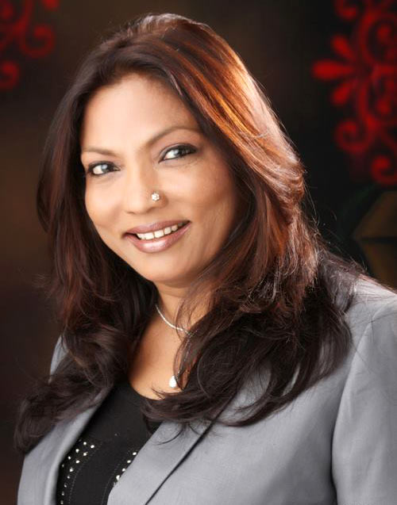
Kalpana Saroj
The original “Slumdog Millionaire” of India.
Born to a Dalit family, she was subjected to all kinds of injustice and being a girl only added to her miseries.
She was married away at the age of 12, faced mental and physical abuse.
She attempted suicide after being ostracized by the villagers.
She started working in a garment factory.
She started a tailoring business.
Identified opportunity in furniture business and achieved success.
She further diversified into successful real estate business. Her success is attributed to her networking and entrepreneurial skills.
She was on the board of Kamani Tubes. In 2001, it went into liquidation, she took it over, restructured it and brought it back to profit.
Kalpana Saroj was awarded the Padma Shri in 2013. She was inducted to the board of Bhartiya Mahila Bank.
Her business process focus
Quality | 100%
Purity | 99%
Design | 90%
Product diversity | 85%
Her advice
Hard work and only hard work can prevent you from failing.
Apply yourself fully and work with single minded vision –
Success will you yours.

Slide 23
The Story of NastyGal

Slide 24
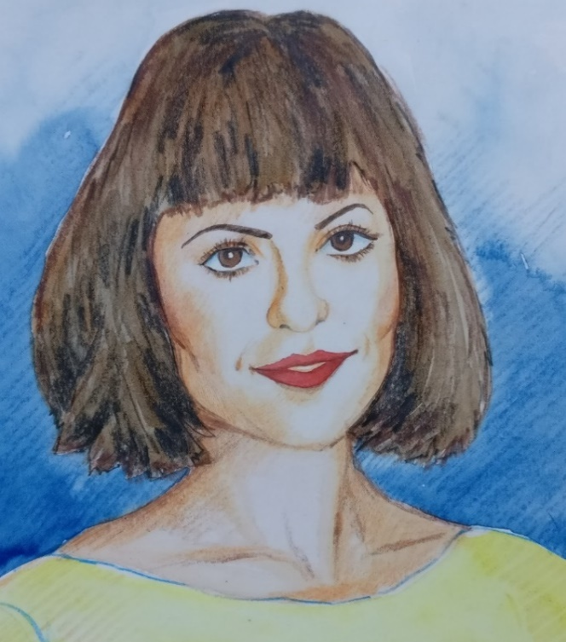
Sophia Amoruso had a very difficult childhood.
She became an entrepreneur by sheer chance.

Slide 25
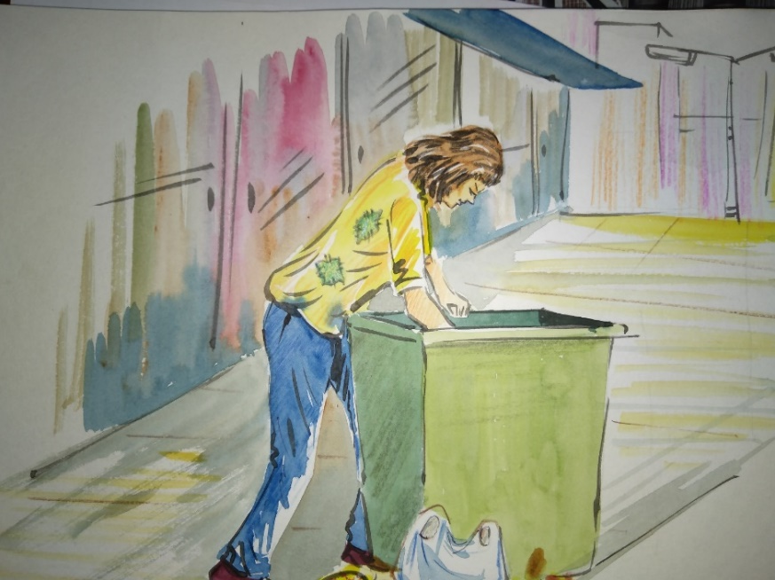

Sophia Amoruso of Nasty Gal (nastygal.com) Sophia Christina Amoruso – born on April 20 1984
Rags-to-riches-to - (???)-to-riches story in the world of entrepreneurship

Slide 26
Sophia Amoruso – Early life
She is of Greek, Italian, and Portuguese descent.
Diagnosed with depression and attention deficit hyperactivity disorder (ADHD) in her adolescence.
Her parents divorced.
Photography school dropout with taste of vintage clothing.

Slide 27

Sophia Amoruso
At the age of 17, left home and travelled to Sacramento, California.
Did various odd jobs, including working in a bookstore and a record shop.
She found herself dumpster diving and stealing.

Slide 28
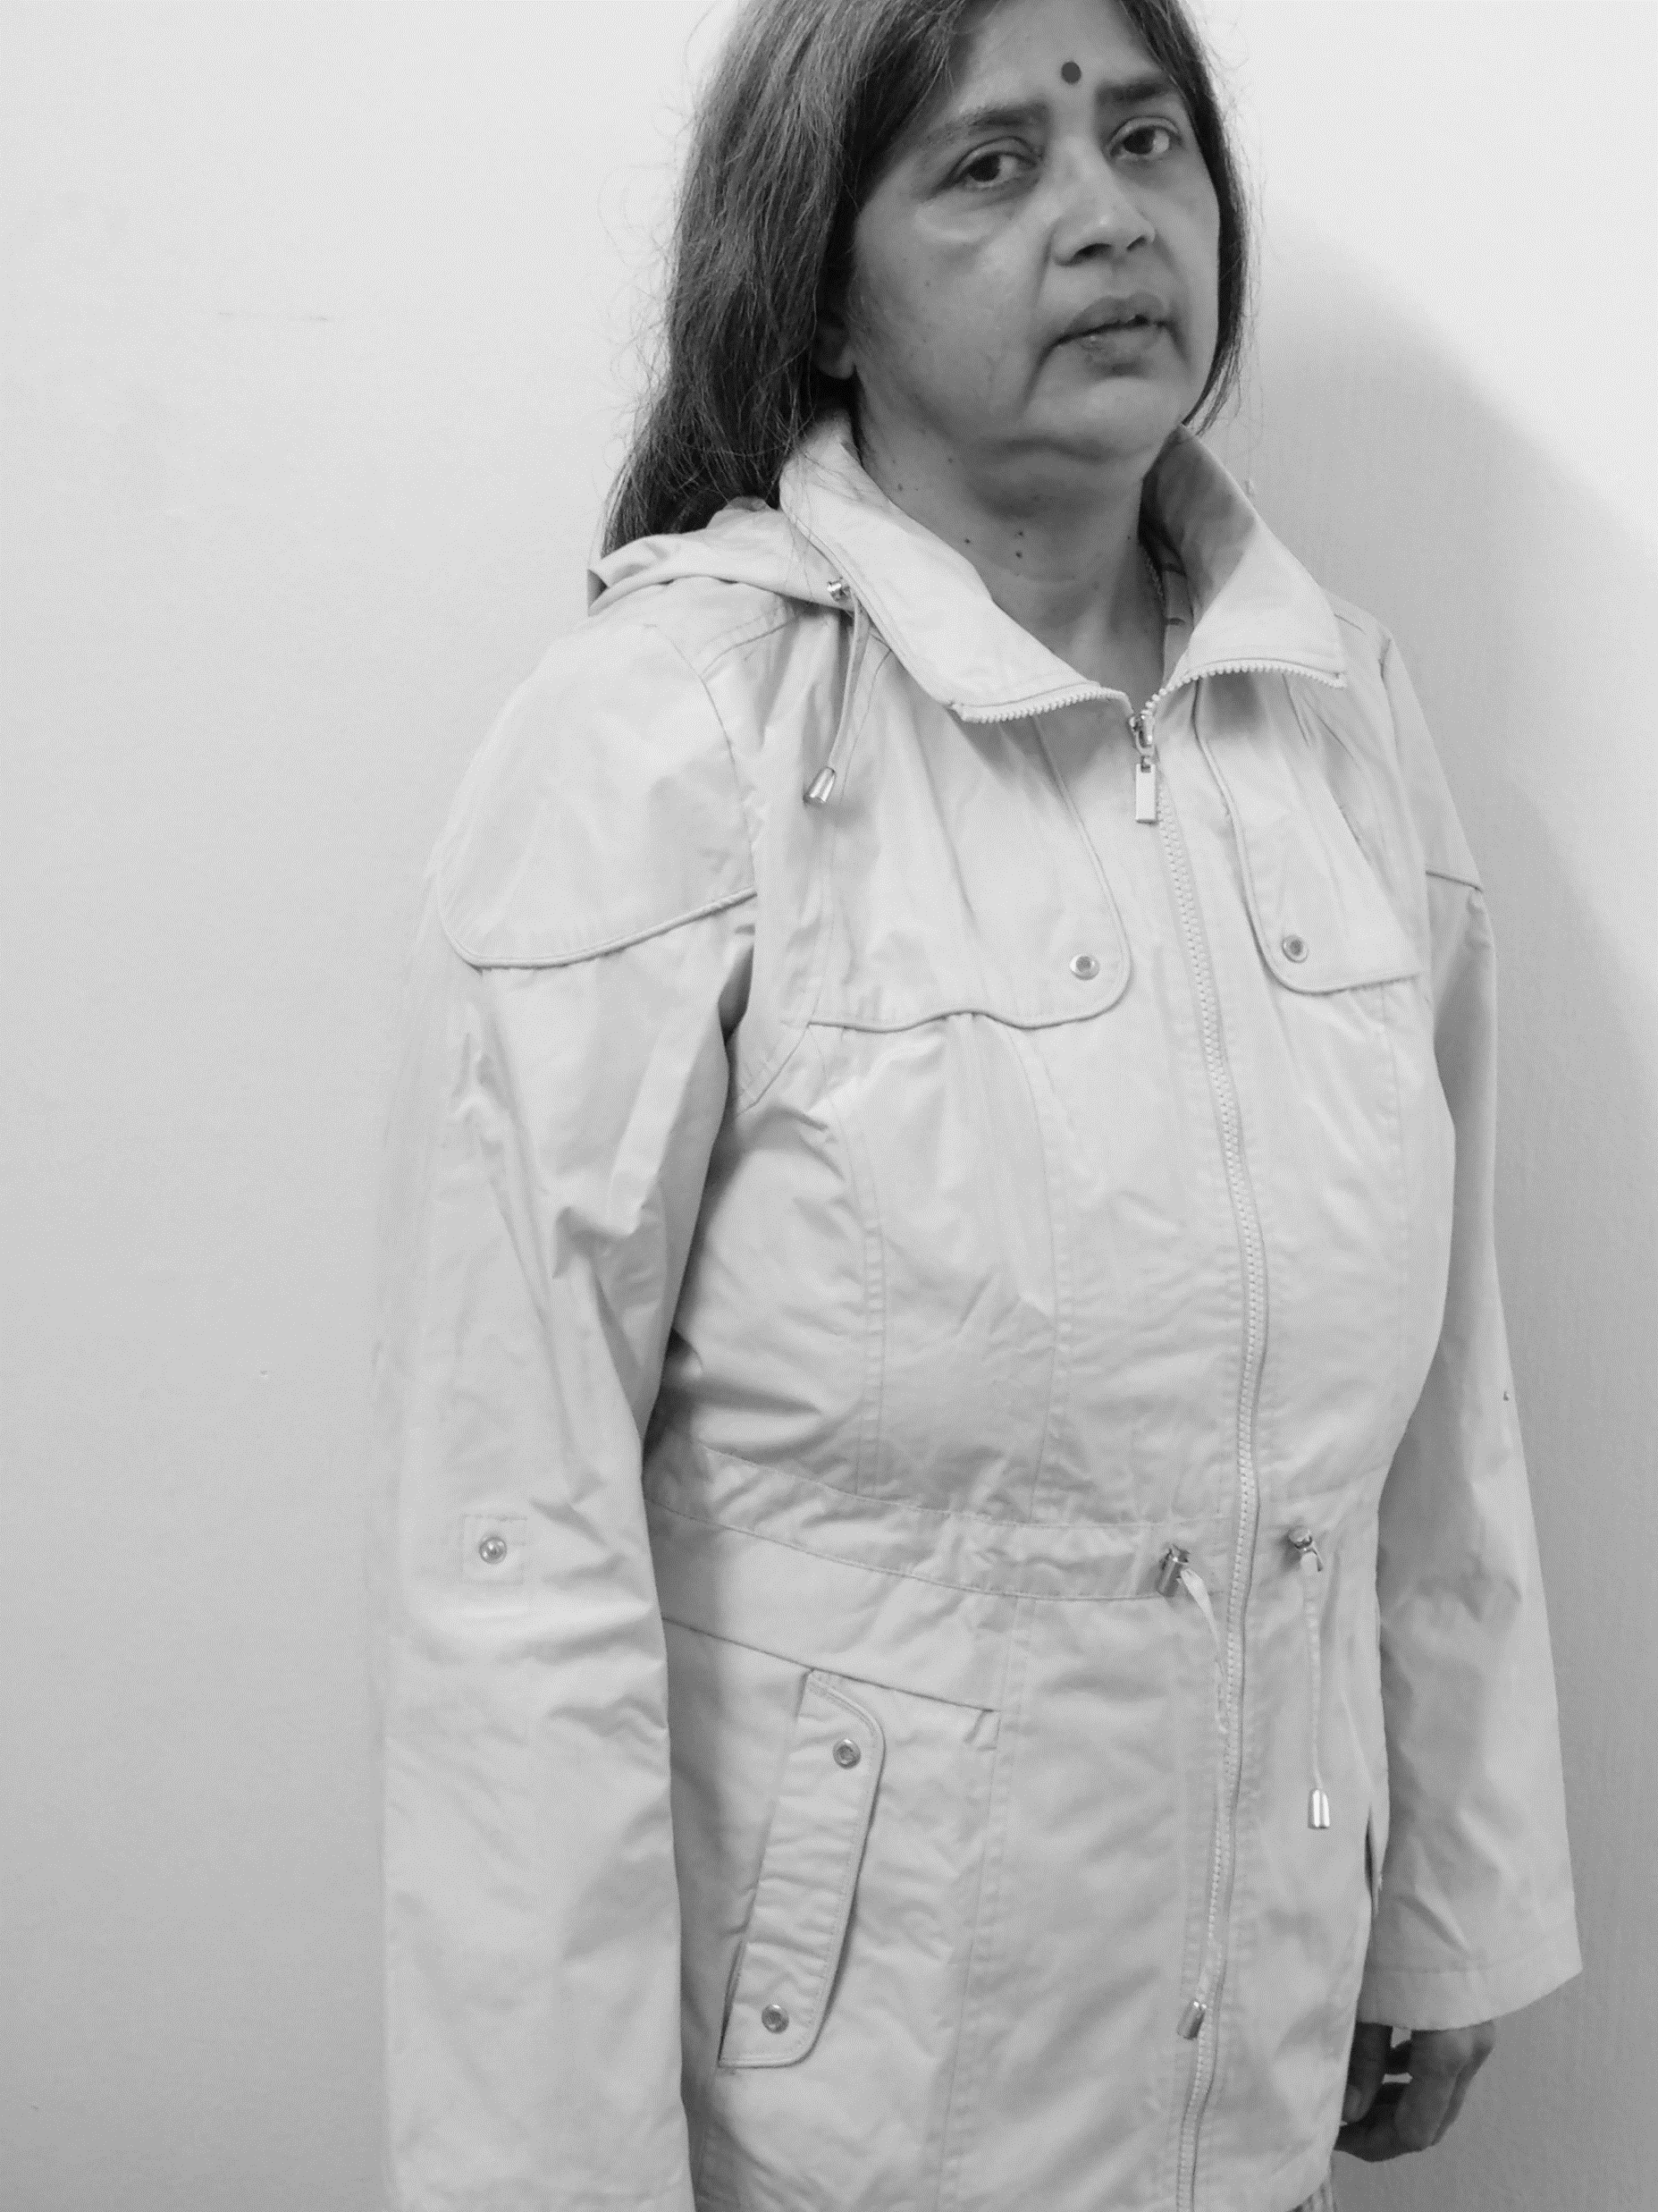
Sophia Amoruso
Bought a leather jacket at a local Salvation Army store for $18.
She posed herself as model wearing the jacket.
Created page on Myspace by the name ‘Nasty Gal’ and posted the picture to sell the jacket.
Sold the jacket for $1000. She repeated the process with unbelievable success.
An entrepreneur and a business venture were born.

Slide 29

NastyGal
She continued this activity for a while.
She launched a formal company - Nasty Gal at the age of 22 and quickly developed a loyal following.
When the users of NastyGal crossed 60,000, Amoruso created her own brand of vintage clothing.

Slide 30
Nasty Gal
By 2010 Amoruso was entertaining offers from a host of venture capital firms. Mostly, she turned them down.
However, when she expanded in 2012 she accepted a VC deal for $50 million equity investment.
In 2013, Amoruso was 29 years old and in charge of a $240 million (₹1800 crore in present dollar value) technology based fashion retail empire.
In 2016, she was named one of the richest self-made women in the world by Forbes.

Slide 31
Some Enviable Metrics of Nasty Gal
Look at some of her metrics that any entrepreneur would envy:
About a quarter of her customers used to visit the site at least once a day and stay there for at least seven minutes.
The top 10% of these customers visit the site more than 100 times a month.
Many admit that they refresh the site every half an hour or so.
She sold 93% of inventory at full price whereas the industry is characterized by mark down.

Slide 32
Five strategies were attributed to the Success of NastyGal
1. Her understanding of the customers
2. An eye on profit
3. Her social skills
4. Consistent philosophy
5. Uncompromised & consistent ethics.

Slide 33
1. Her understanding of the customers
Sophia knew the customers she was serving to, and knew that there is lack of understanding by competitors.
Sophia could understand the changing tastes and aspirations of all her customers and that is why they came back to Nasty Gal repeatedly.
She knew her customers so very well.

Slide 34
2. An eye on profit
Her philosophy was to sell things for more than she bought them.
Therefore, she made profit from day one.
She developed a pin-sharp sense of who her customers were and what they were willing to pay a premium for.

Slide 35
3. Nasty Gal used to do the following to boost their social connection
She created visibility by encouraging customers to use the hashtag #NastyGal across all social networks
Engaged them into brand conversation and quickly responded to any question or comment.
Everyone in the company were marketers and no separate marketing department.
Every post in the portal had an actual image of the product.
Content included useful DIYs on the topics of make up, hair, garment customisation.
Boosted the ego by posting images of their customers, whether they are bloggers, celebrities or normal human beings.
Notes:
Fabindia

Slide 36
5. Uncompromised & consistent ethics.

Slide 37
Sophia Amoruso: From Nasty Gal To Girlboss
However, Sophia diverted her attention to too many other things and the business was neglected.
In November 2016, she had to file for bankruptcy protection.
Amoruso resigned as executive chairwoman.
In February 2017, Nasty Gal was sold for $20 million.
Amoruso founded Girlboss Media in the same year.
Current net worth is around $10 million.

Slide 38
Sophia Amoruso: Fight Back
A Netflix comedy series “#GirlBoss” partially based on the story of ‘Nasty Gal’ was telecast in 2017.
She recently raised a $3.1 million funding to grow the burgeoning media platform.
Amoruso has expressed the desire to be the next Oprah Winfrey for the millennials and beyond with her mission to help women succeed on their own terms.

Slide 39
https://www.girlboss.com/about
Our Mission
We exist to redefine success for millennial women by providing the tools and connections they need to own their futures.
Our Purpose
To create a new reality where women can make progress personally, professionally, and in service or others.
Our values
We take our work seriously, but we don't take ourselves seriously.
We do more with less, but raise our hands when the company or our wellbeing is at risk.
we have real conversations about where we are and what we need to succeed-and are comfortable with change.

Slide 40
Four Reasons Why it Failed
Cash is the king (you can’t afford to burn cash at will).
One must always respect money.
As success embraced Amoruso, she started growing a knack for everything, except for the business itself.
After raising venture capital, she moved the company into lavish L.A. headquarters, opened two brick-and-mortar stores, leased a dedicated distribution centre and spent a fortune on marketing.
This led to an enormous leap in burn-rate and was unsustainable.

Slide 41
Reason 2.
2. If you want to be a CEO, you have to love your job.
Amoruso started loving everything else but her job as the CEO. She started writing a book, some podcast, and doing a TV show – all took her attention and the business became a victim.

Slide 42
Reason 3.
3. Starting is easy, scaling is hard.
Mark Zuckerberg hired Sheryl Sandberg very early, as his chief operating officer, in order to flawlessly scale the business.
We must not be ignorant about our limitation and we should hire a talented executive team with complementary skills early on.
The executive team would bring professionalism and you would feel as if the business is running autonomously.
Amoruso failed on that. Her actions gave the sense as if success had been achieved. But success is mostly not a goal, but a process.

Slide 43
Reason 4.
4. Success is not a goal, it’s a way of life in the long run. If the objective is to make a quick million, entrepreneurship is not for them.
Amoruso did not have a long-term perspective.

Slide 44
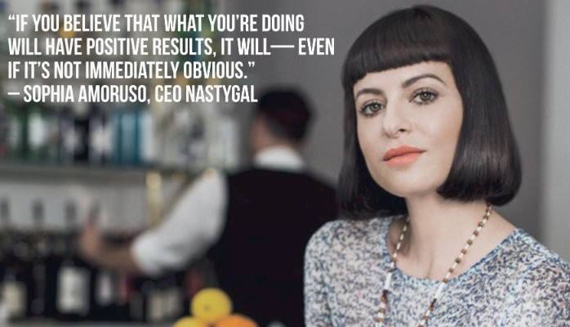
Words of wisdom
“IF YOU BELIEVE THAT WHAT YOU’RE DOING WILL HAVE POSITIVE RESULTS, IT WILL-EVEN IF IT’S NOT IMMEDIATELY OBVIOUS” – SOPHIA AMORUSO, CEO NASTYGAL
Source:
https://www.linkedin.com/pulse/5-key-elements-brand-strategy-nasty-gal-context-denise-perez/

Slide 45
Anyone can become an entrepreneur.
One can choose to adopt type of business based on domain knowledge, experience, understanding of the particular business, tenacity and readiness to assume risk and have to be passionate about execution.
Dream big, remain passionate, and focus your energy to execute the dream.

Slide 46
References:
Book: Entrepreneurship by Robert D. Hisrich
https://www.youtube.com/watch?v=rjEzg__6ztc
Various Wikipedia pages
www.nastygal.com

Slide 47
Thank you

